Slide 1

Robustification of Behavioral Designs against Environmental Deviations
Changjian Zhang

Slide 2
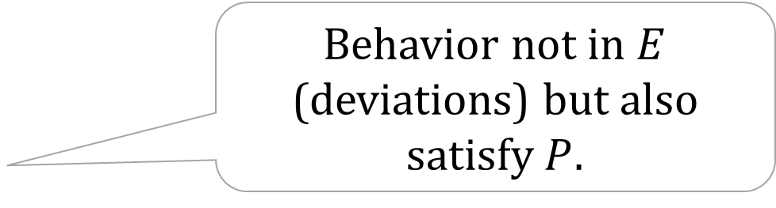

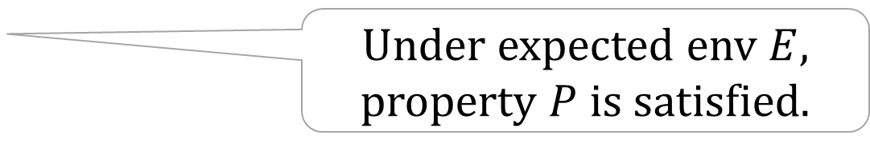
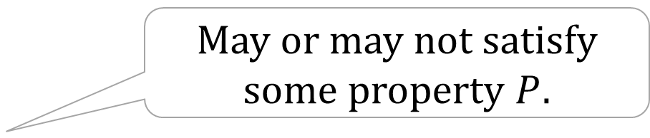


Robustness Recap – FSE 20 Work
May or may not satisfy some property $P$.
All possible interactions with the Machine $M$
Behavior not in $E$ (deviations) but also satisfy $P$.
Robustness $Δ$
Expected Env. $E$
Under expected env $E$, property $P$ is satisfied.
Notes:
We consider a machine and its environment, and also a property that we want the system to satisfy.
This big orange circle describes… For example, the coffee machine in TCS, you can press the buttons in any order, some of them can make you a coffee, some of them can break the machine.
Then, this small circle describes the expected environment, for example, you have to follow a particular order to use the coffee machine.
Finally, this blue circle describes the robustness, i.e.,

Slide 3
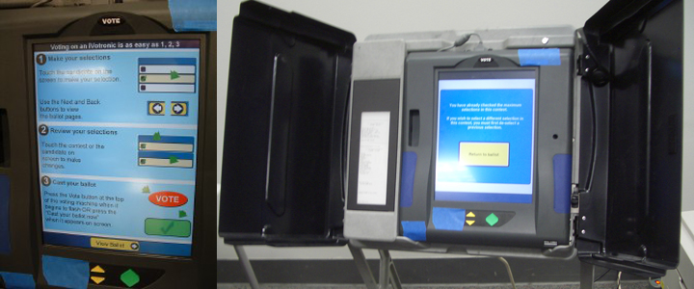
A Voting Machine Example
The machine must record the vote selected by the voter.
Notes:
Consider A voting machine example. Apparently, safety requirement that … However, this machine was involved in a real vote fraud case in Kentucky back in 2010 where the malicious users exploit the design vulnerability of this machine to change the voter’s vote.

Slide 4
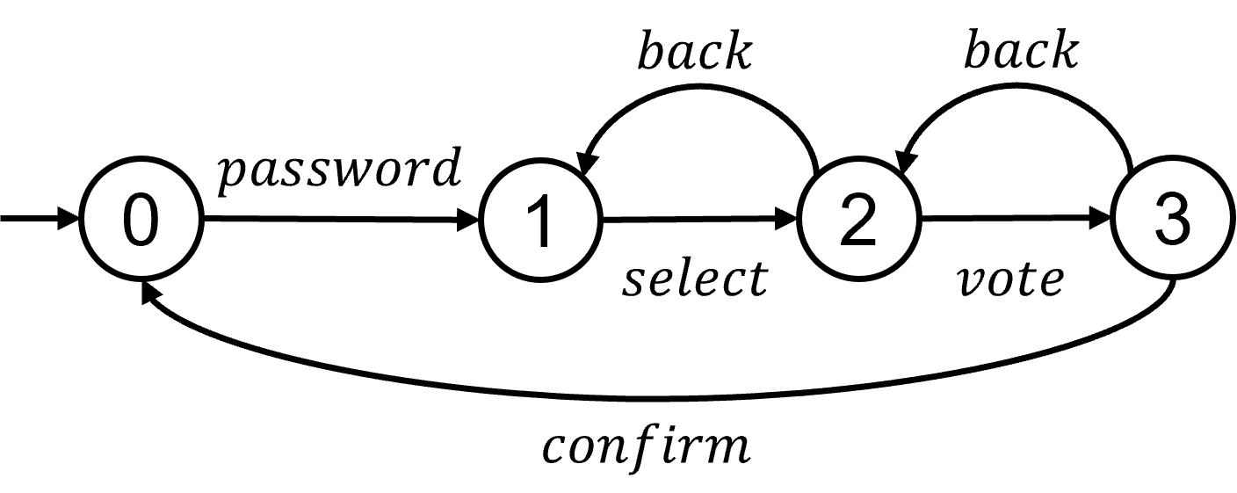
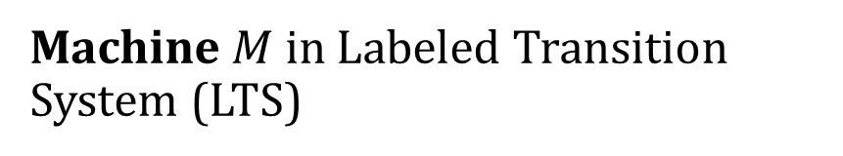
All Possible Interactions
Enter identity (password);
Select the candidate;
Vote for them or Back to change selection;
Confirm the vote or Back.
Machine $M$ in Labeled Transition System (LTS)
Notes:
Consider all the possible interactions with the machine.

Slide 5
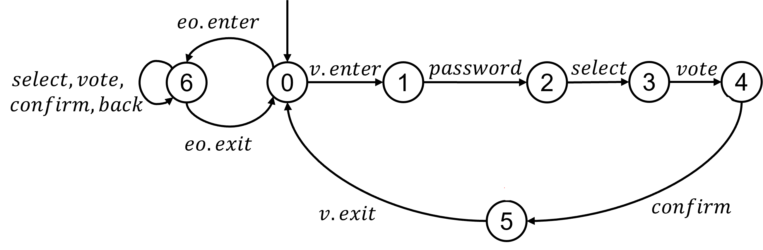

Expected Behavior of the Environment
Voter:
Enter password;
Select a candidate;
Vote for them;
Confirm;
Leave.
Official: All the above except password.
Environment $E$ in LTS
Notes:
The expected behavior of the environment which is the user. The developer of this machine might expect the voter to…

Slide 6


Is it Safe and Robust?
Safety: Model checking $M||E⊨P$.
Compute robustness $Δ$: the machine can tolerate some deviations,
E.g., $Password→Select→Back→Select→Vote→Confirm→Leave$.
$$back$$

Slide 7
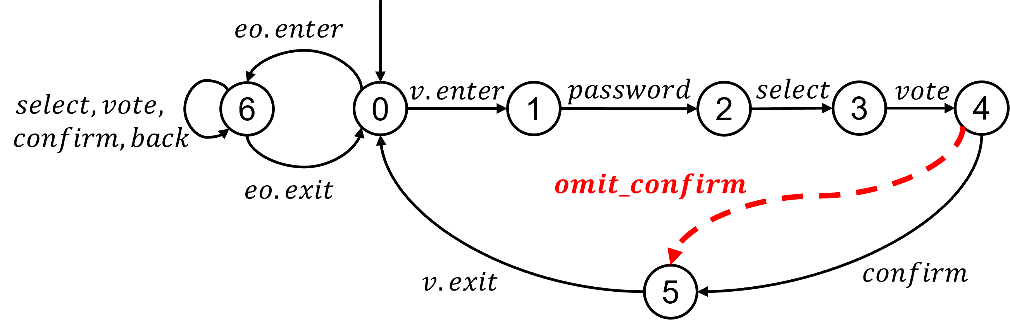
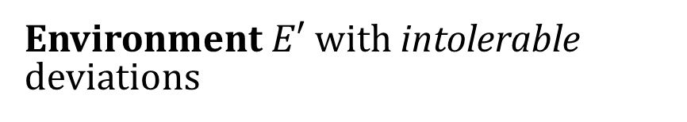
Intolerable Deviations
Voter:
Enter password;
Select a candidate;
Vote for them;
Forget to confirm;
Leave.
Malicious Official:
Back twice;
Select, Vote, and Confirm.
Environment $E′$ with intolerable deviations

Slide 8

From Robustness to Robustification
Given a new environment $E′$ with intolerable deviations, i.e.,
$$M||E′⊭P$$
Robustification: Construct a redesign $M’$ such that
$$M^{′}||E′⊨P$$

Slide 9
Key Contributions – ICSE 23 Work
Propose the (optimal) robustification problem.
A solution to solve it as a multi-objective optimization problem and by using supervisory control.
An algorithm to search for optimal solutions.
Case studies and Comparisons with related techniques.
Notes:
In this talk, I will not talk about a lot of the details but focus on the high-level ideas instead.

Slide 10
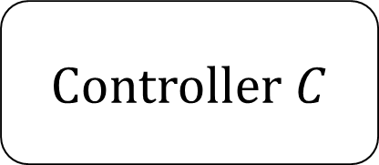
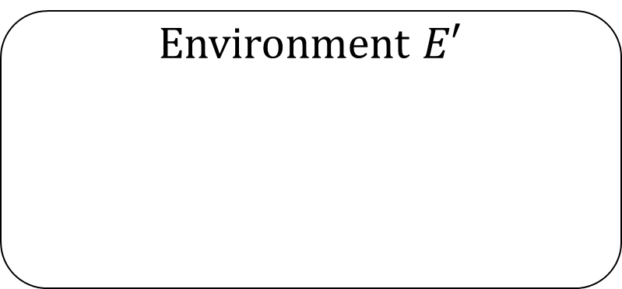
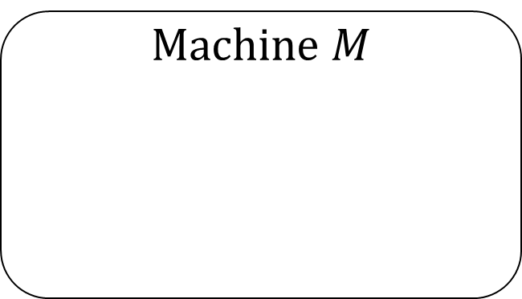
Robustification by Supervisory Control
Control the machine or env by enable/disable actions.
Observe events from the machine and env
Controller $C$
Machine $M$
Environment $E′$
Notes:
First, briefly introduce supervisory control. And this can be used to synthesize new designs.

Slide 11
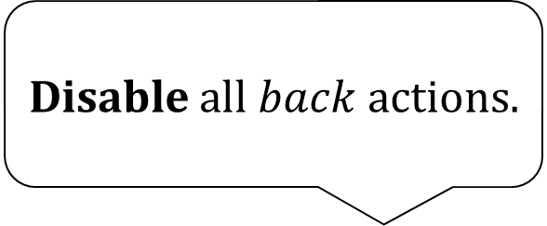

An Example of Control
Disable all $back$ actions.
Since $omit_confirm$can occur,
Controller $C$
Machine $M$
Environment $E′$
X
X
Notes:
But this might not be a good design, since no one even the voter cannot change their vote.

Slide 12
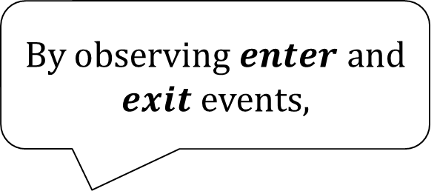
Another Example of Control
ID Scanner? Additional cost?
It can disable back/confirm as needed.
By observing $enter$ and $exit$ events,
Controller $C$
Machine $M$
Environment $E′$
Notes:
But in this case, to observe enter and exit events, do we need a ID scanner to decide that? Will this sensor introduce additional cost? Probably yes!

Slide 13
Optimal Robustification Problem
Quality goals:
Preserving behaviors from the old design as much as possible;
Reducing cost of changes.
Trade-offs:
Given events to observe and control, a supervisory controller can preserve the maximum possible behavior.
With more events, it can preserve more behavior but require a larger implementation cost.

Slide 14
Multi-Objective Optimization
Problem:
Find the set of events with the minimum cost that preserves the maximum possible behavior by supervisory control synthesis.
Algorithm:
Decide on behaviors and Start with all events;
Synthesize a controller with the given events;
Remove some events to reduce cost, and back to 2;
Remove some desired behaviors, and back to 1.
Cost
Behavior
Notes:
Through this process we can find pareto solutions or solutions close enough to the pareto-front.

Slide 15
Evaluation
RQ1 (Scalability): How well do our robustification algorithms scale? Do our search heuristics improve the performance?
RQ2 (Quality of robustification): How does our robustification approach compare to other existing methods in terms of the quality of the generated solutions?

Slide 16
RQ1: Scalability
Evaluated on:
Voting machine;
Radiation therapy machine (similar to Therac-25);
Infusion pump machine.
Synthesize a new design for a middle size machine with 760 states in 12.47s.

Slide 17
RQ2: Comparisons
OASIS: synthesizes new designs against environmental deviations using controller synthesis.
Differences: no quality goals like ours.
Results:
We can find optimal solutions that OASIS cannot.
No big performance overhead.
Their search heuristics could be complementary to ours.

Slide 18
Reflections on Paper Writing Experience
Rejected twice: ICSE 2022, FSE 2022.
Successful rebuttal in ICSE 2023.
Major concerns from reviewers, and How we improve our work.
Lessons learned.

Slide 19
ICSE 2022: Evaluation and Scalability!
All reviewers agree that the paper tackles an interesting problem, […] The main criticisms, […], concern the scalability and the evaluation of the approach.
As for the scalability, the reviewers appreciated authors’ effort […], but […] at least a preliminary analysis of scalability should have been in the submitted paper. The evaluation available […] has been seen more like an illustration of the approach rather than a full-fledged evaluation.

Slide 20

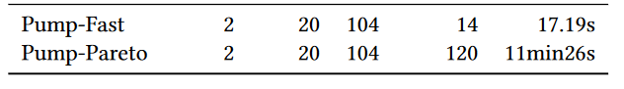
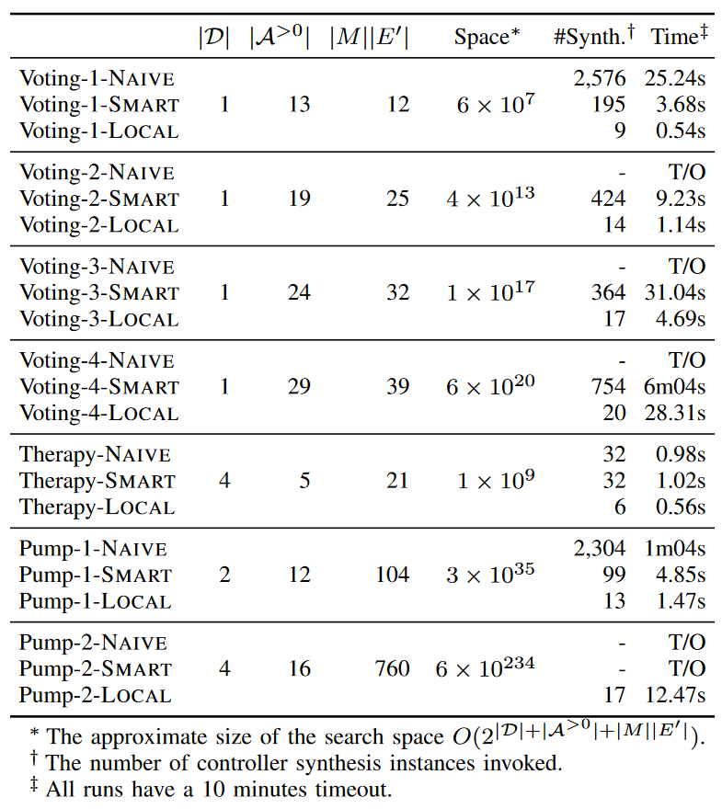
More Work on Engineering
Revision 1: Simplify a theory that won’t make a big difference in practice.
Revision 2: Leverage state-of-the-art solver and libraries;
Migrate from Python to Java;
More advanced data structures, e.g., BitSet, Compact FSM.

Slide 21
FSE 2022: Comparison!
No comparison with state of the art is provided.
It is hard to evaluate how good the robustification is since the paper does not present comparisons with any related technique […].
Can the proposed approach be seen as a special case of model repair?
Concerns regarding […] the lack of a comparison with related approaches […], and […] some aspects that need to be better explained […] lean towards rejection.

Slide 22
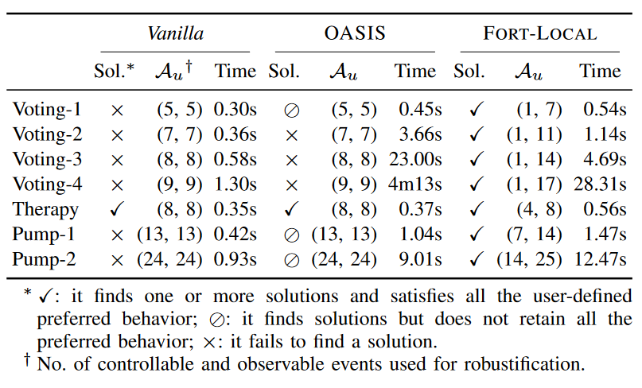
Introducing Baselines and Comparisons
Present a baseline (ground truth) to compare to.
Implement the technique in OASIS.
Design the comparison metrics and apply to our case studies.

Slide 23
Lesson 1: Engineering Matters!
Python for everything? Probably no!
Data structures and algorithms! You still need them as a PhD.
Help identify unnecessarily complex theories.
Convince others to try your tool.
Bonus: find bugs in state-of-the-art tools!

Slide 24
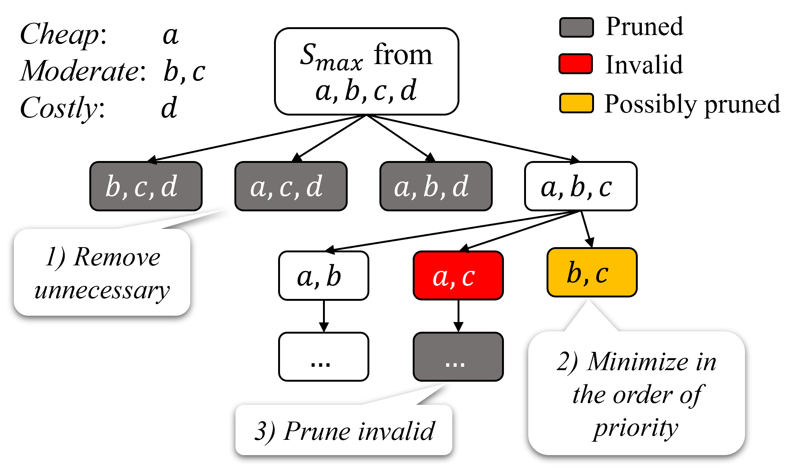
Lesson 2: Highlight Your Contributions!
Can we [you] use some heuristics to speedup the algorithm? [Even though we do use.]
Briefly mention in text
A whole new section of discussion
Specifically, in each iteration, the […] search uses “brute-force” to enumerate all combinations […]. When […], the followed branches get pruned. […]

Slide 25
Lesson 3: Be Patient and Don’t Be Mad!
FSE 2022 Review: No comparison with state of the art is provided.
We: (There’s no fair comparison.) […], our […] problem is novel, and the reduction to other similar, existing problems is non-trivial. […] To enable a fair comparison, those existing techniques would need to be extended in a non-trivial way.
ICSE 2023 Review: Existing approaches do not have the cost information; therefore, comparison of the costs is not fair.
We: … (Yes, I agree!!!)

Slide 26
Final Words
How to face criticisms and be stronger?
Self-reflection, exam criticisms objectively.
View criticism as an opportunity for growth and learning.
Get support from friends and family.
Celebrate progress and successes.
Credit to ChatGPT!

Slide 27
Tables
Notes:
TODO: Only show the results for Voting-1 and Pump2
TODO: another page on OASIS, is another similar method, but they do not consider costs and preserving behavior. And our performance is comparable.

